Slide 1
Business Understanding & Analytical Planning
Project Overview
Business Context
Modern organizations operate in increasingly dynamic financial environments requiring real-time, actionable insights into financial health, cost drivers, revenue streams, and efficiency metrics. As a Financial Analytics Consultant for the Analytics Center of Excellence, the mission is to transform raw financial data into decision-ready executive dashboards that shape fiscal performance and strategic direction.
Prepared by: Dipanshu Singh

Slide 2
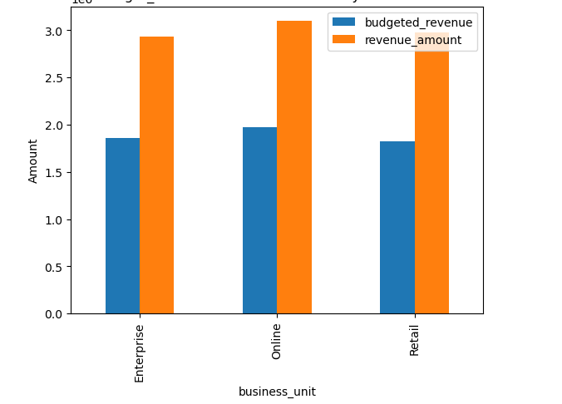
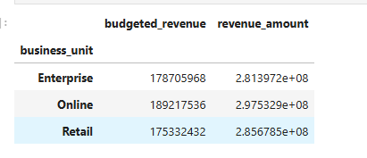
Business Core
Budget vs actual revenues
Business Optimization Insights
Monitoring key metrics and variances to identify growth opportunities and optimize budget allocation across all business segments.

Slide 3
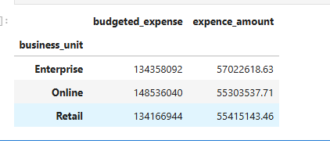
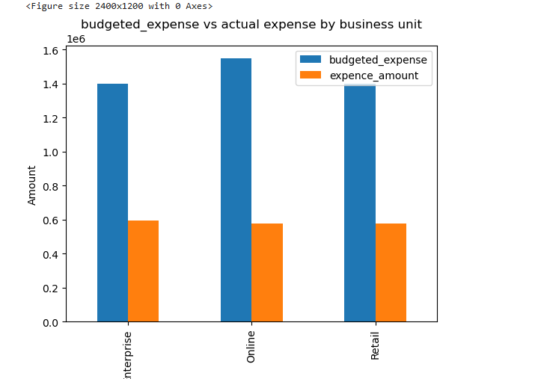
Budget vs actual expences
Analysis
Monitoring expense management performance across enterprise, online, and retail business units to ensure financial discipline and operational efficiency .
Dashboard Tracking budget adherence and identifying variances to optimize spending and improve cost management strategies across all business segments..

Slide 4
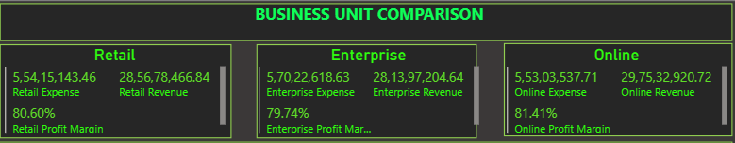
Business Unit Comparison
Business Unit Performance Comparison
Analyzing revenue, expenses, and profit margins across retail, enterprise, and online divisions to identify top performers and improvement areas.
Profitability Insights Dashboard
Highlighting margin efficiencies and cost structures to drive strategic resource allocation and business unit optimization decisions.

Slide 5
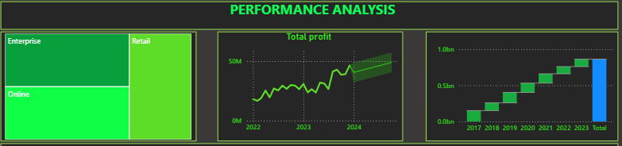
Performance Analysis
Performance Analysis Overview
Tracking total profit growth and business unit contributions across multi-year timeline to measure organizational success and momentum .
Profit Growth Trajectory
Analyzing enterprise, retail, and online performance trends to identify growth drivers and strategic opportunities for continued expansion.

Slide 6
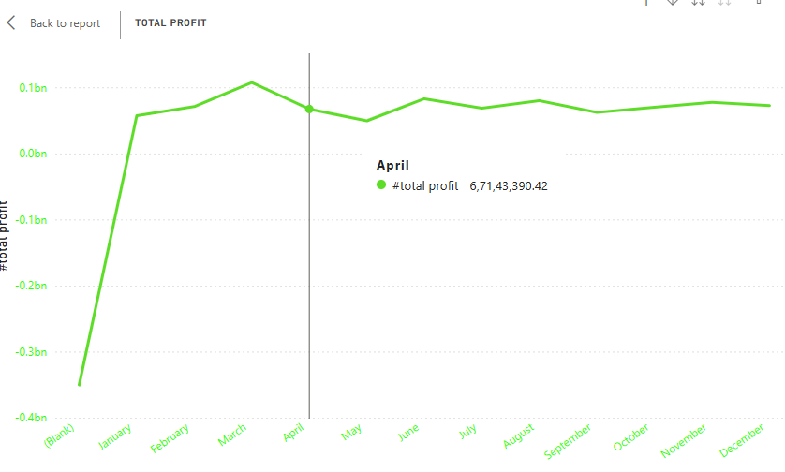
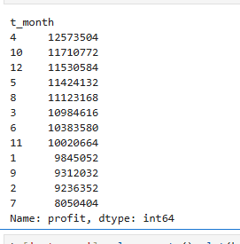
Analyze profitability
Strong Q4 Performance - April, August, October and December show peak profits above 11.5M, indicating consistent quarterly
strength.
Mid-Year Dip - July shows significant profit drop (8M), suggesting seasonal slowdown or operational challenges needing investigation.

Slide 7
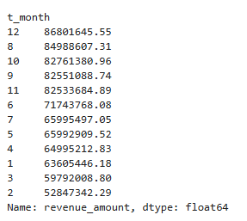
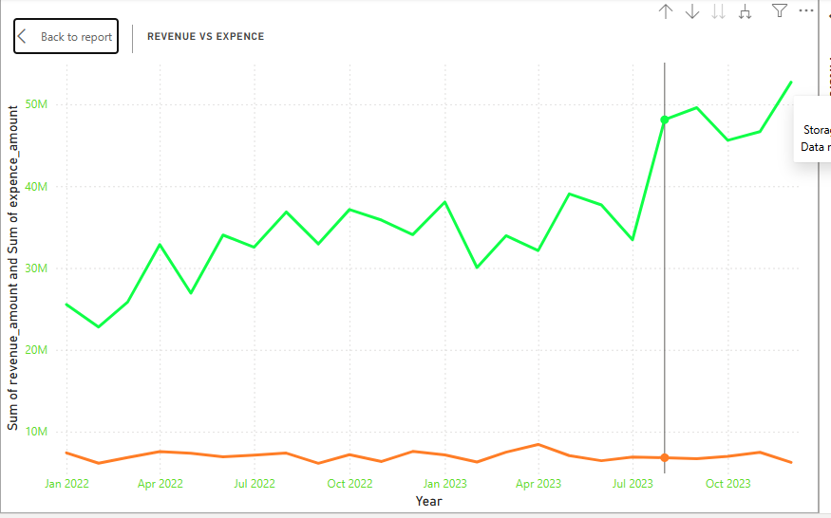
Understand revenue patterns
Clear Q4 Revenue Dominance - December, August, and October are top revenue months, showing strong year-end performance cycle.
Q1 Revenue Challenge - February and March show lowest revenue, indicating seasonal business pattern with slow start to the year.

Slide 8
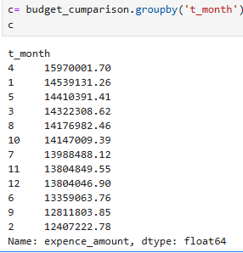
Understand expence patterns
Stable Expense Management - Expenses remain relatively consistent year-round (12M-16M range), showing good operational cost control.
April Cost Peak - Highest expenses in April don't align with revenue peaks, suggesting potential inefficiency or strategic investment in Q2.

Slide 9

Key KPIs
Exceptional Profitability & Efficiency - 59.45% margin demonstrates highly effective cost control and premium pricing power.
Strong Budget Management - 59.15% positive variance indicates significant revenue over-performance against forecasts.

Slide 10

BUSINESS UNIT - ENTERPRISES
Extraordinary Enterprise Performance - 182.68% profit margin indicates massive operational efficiency and premium value delivery.
Significant Revenue Over-Achievement - 57.46% budget variance shows enterprise vastly exceeding revenue targets.

Slide 11

BUSINESS UNIT - ONLINE
Online Division Excellence - 172.77% profit margin demonstrates highly scalable digital operations with superior unit economics .
Strong Target Over-Performance - 57.24% budget variance confirms online channel significantly exceeding revenue expectations.

Slide 12

BUSINESS UNIT - RETAIL
Retail Dominance - 179.94% profit margin shows exceptional in-store efficiency and strong customer value proposition .
Highest Budget Over-Performance - 62.94% variance indicates retail division most significantly exceeding revenue forecasts.

Slide 13

REGION – EAST
East Region Exceptional Performance - 231.35% profit margin indicates this is the most profitable and efficient operational region.
Highest Budget Over-Achievement - 63.60% variance shows East region significantly outperforming all revenue expectations.

Slide 14

REGION – NORTH
North Region Peak Profitability - 240.39% margin is the highest across all regions, indicating superior cost management and pricing power.
Strong Revenue Over-Performance - 57.45% budget variance demonstrates consistent target exceeding in northern markets.

Slide 15

REGION – SOUTH
South Region Excellence - 239.77% profit margin nearly matches North region, showing consistently superior profitability across multiple markets.
Robust Revenue Performance - 57.85% budget variance indicates strong, reliable over-achievement against financial targets.

Slide 16

REGION – WEST
West Region Efficiency Leader - 239.99% profit margin demonstrates exceptional cost control and operational excellence.
Consistent Target Exceeding - 57.71% budget variance shows reliable revenue over-performance in western markets.

Slide 17
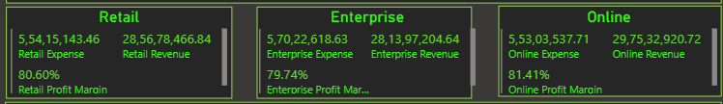
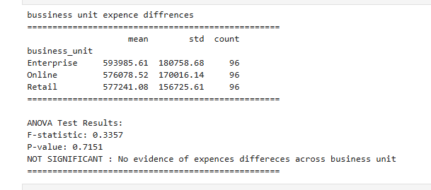
Hypotheses H1
Uniform Expense Management - No significant expense differences across business units (p=0.7151), demonstrating consistent cost control organization-wide.
Standardized Operational Efficiency - Enterprise, Online, and Retail maintain similar expense profiles, indicating unified financial discipline and spending protocols.

Slide 18
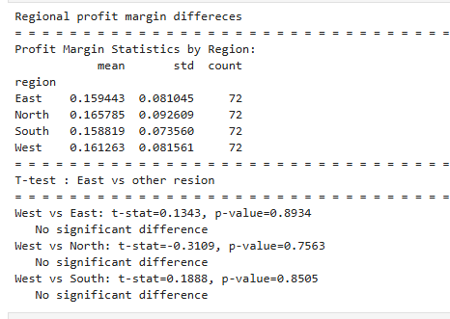
Hypotheses H2
Regional Profitability Consistency - All regions show nearly identical profit margins (~16%) with no statistically significant differences (p>0.75).
Uniform Performance Model - East, North, South, and West demonstrate standardized operational efficiency and pricing strategies across geographic markets.

Slide 19
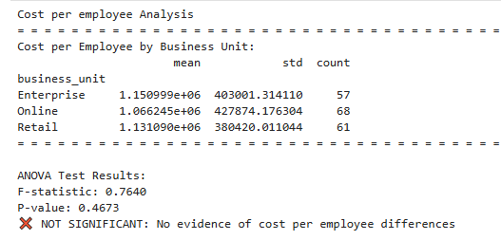
Hypotheses H3
Cost Efficiency Consistency - No significant difference in employee costs across business units (p=0.4673), indicating standardized workforce investment.
Uniform Operational Model - Enterprise, Online, and Retail maintain similar cost structures per employee, suggesting consistent HR policies and compensation scales.

Slide 20
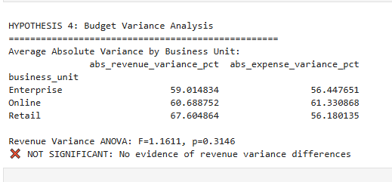
Hypotheses H4
Consistent Budget Performance - No significant difference in revenue variance accuracy across units (p=0.3146), indicating uniform forecasting reliability.
Standardized Planning Process - All business units show similar budget deviation patterns, suggesting centralized and consistent financial planning methodology.

Slide 21
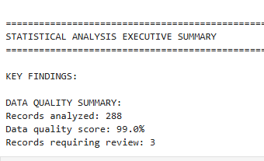
DATA VALIDATION
High-Quality Data Foundation - 99.0% data quality score across 288 records provides reliable analytical basis for business decisions.
Minimal Data Integrity Issues - Only 3 records requiring review ensures confidence in statistical findings and strategic recommendations.

Slide 22
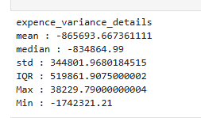
Summary Statistics
EXPENCE VARIANCE
Systematic Budget Over-Estimation - Consistent negative variance (mean: 865K, median: 834K) shows expenses consistently under budget across all units.
Tight Financial Control - Low standard deviation (344K) and IQR (519K) indicate predictable, well-managed spending with minimal outliers.

Slide 23
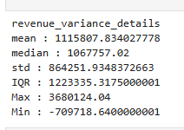
REVENUE VARIANCE
Consistent Revenue Over-Performance - Mean variance of +1.12M shows systematic revenue exceeding budget targets across all business units.
Strong Growth Momentum - High positive median (1.07M) with wide IQR indicates substantial and frequent budget over-achievement in revenue generation.

Slide 24
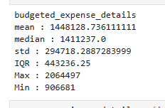
BUDGET EXPENCE VARIANCE
Conservative Budget Planning - Tight expense distribution (std: 294K) with consistent median (1.41M) shows disciplined, predictable financial forecasting.
Controlled Spending Allocation - Narrow IQR (443K) indicates minimal budget fluctuation, reflecting stable operational cost expectations across periods.

Slide 25
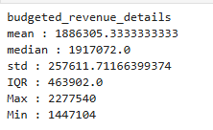
BUDGET REVENUE VARIANCE
Aggressive Revenue Planning - High mean budget (1.89M) with tight standard deviation (257K) shows ambitious but consistent revenue targets.
Optimistic Growth Forecasting - Narrow IQR (463K) indicates confident, stable revenue expectations across all business units and periods.

Slide 26

RESULTE
Massive Revenue Over-Performance - 321M over-achievement demonstrates exceptional sales execution and market demand exceeding all expectations.
Significant Budget Surplus - 249M expense under-run combined with revenue over-performance creates substantial positive financial position.

Slide 27
STRATEGIC RECOMMENDATIONS
1.Capitalize on Growth Momentum
· Increase Growth Investment: Redirect the $249M budget surplus into scaling top-performing regions (North/West) and business units (Retail/Online) · Aggressive Target Setting: Raise revenue targets by 15-20% given consistent over-performance across all units
2. Optimize Operational Excellence
· Standardize Best Practices: Document and replicate the cost control methods driving ~240% profit margins in all regions
· Leverage Data Quality: Use the 99% data integrity to implement predictive analytics for demand planning
3. Strategic Resource Allocation
· Talent Investment: Maintain uniform cost-per-employee across units while focusing on productivity gains
· Seasonal Optimization: Align Q4 resource allocation with the proven December revenue peak
4. Risk Management & Governance
· Conservative Forecasting: Maintain current budget discipline while allowing more ambitious revenue targets
· Continuous Monitoring: Implement real-time KPI dashboards to sustain current performance levels
Bottom Line:
The organization has achieved elite operational efficiency—focus should shift to strategic growth acceleration while maintaining the exceptional cost discipline that drives unprecedented profitability.

Slide 28
THANKES YOU

